Slide 1

R for Psychological Science
https://psyr.org
Danielle Navarro
d.navarro@unsw.edu.au
(Intro slides: PSYC 3361)

Slide 2
install.packages("usethis")
usethis::use_course("http://psyr.org/part1_core.zip")

Slide 3

Hi there!!!
Your name & area of your internship
Any previous experience in programming?
Goals?
What skills would you like to acquire?
What do you think you might need in your work?
Anything you would like to share!

Slide 4
Course objectives
It’s partly about R …
Be able to read and write basic programs in R
Be aware of what you can do with R
But it’s also broader …
Be aware of technical options that are available to facilitate psychological research
Develop and apply technical skills to tasks relevant to research in psychology

Slide 5
You control this class!
The class is informal, relaxed & collaborative
Assessment is minimal:
Write a learning log (next slide) each week
The idea is for you to do something you like
So what is the instructor even here for?
The writer of notes … psyr.org
Help with debugging … things breaks when you code. They break a lot! I’m here to help 😁

Slide 6
Learning logs
After each class, create a post on Moodle!
Something like this:
My goal for today’s session was . . .
I spent the session . . .
The things that went well were . . .
The things that were challenging were . . .
Next time I want to ...
I will read and comment on them.
Classmates can also read and comment

Slide 7
Course timeline
(It’s flexible though)
 | Week 1 | Week 2 | Week 5 | Week 6 | Week 9 | Week 10
Programming
Tidyverse
Project

Slide 8
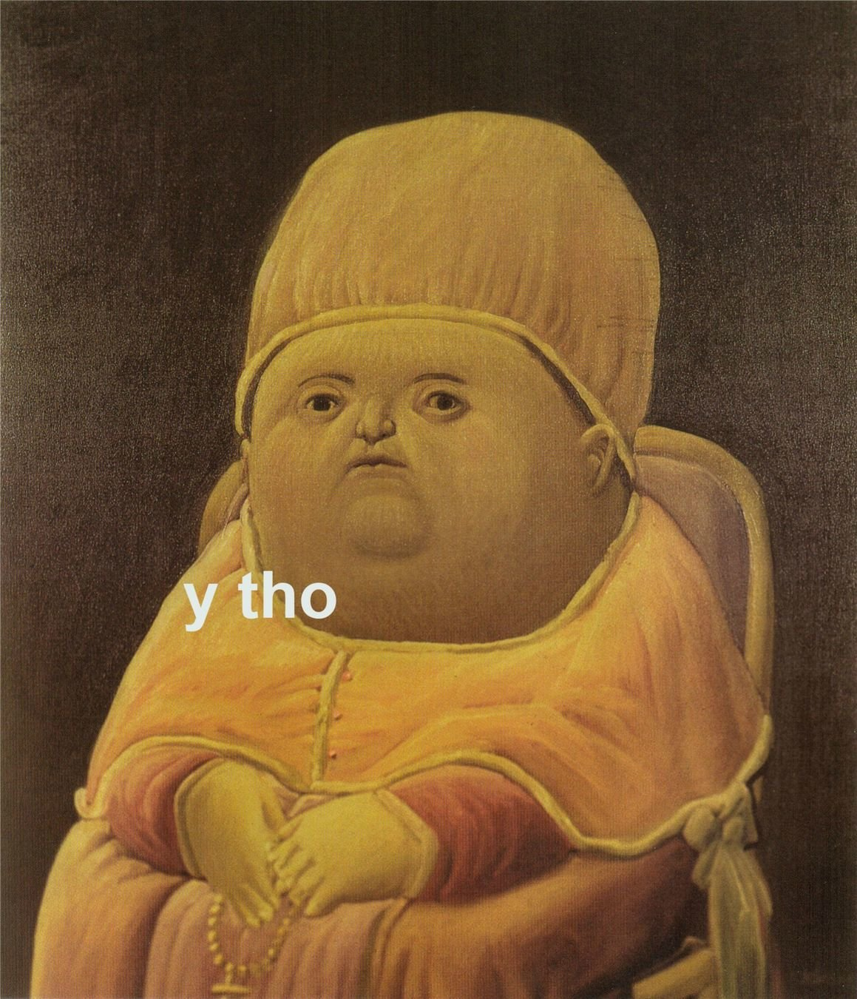

Slide 9
reward
R, Python, etc
SPSS, Excel, etc
effort

Slide 10
Goal 1: convince you that the payoff is real
Goal 2: help you get closer to the point where it becomes rewarding

Slide 11
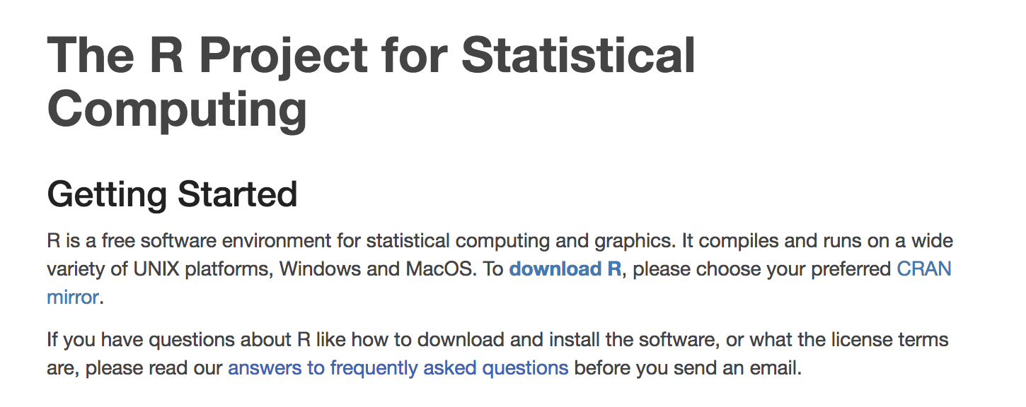
Statistical computing

Slide 12
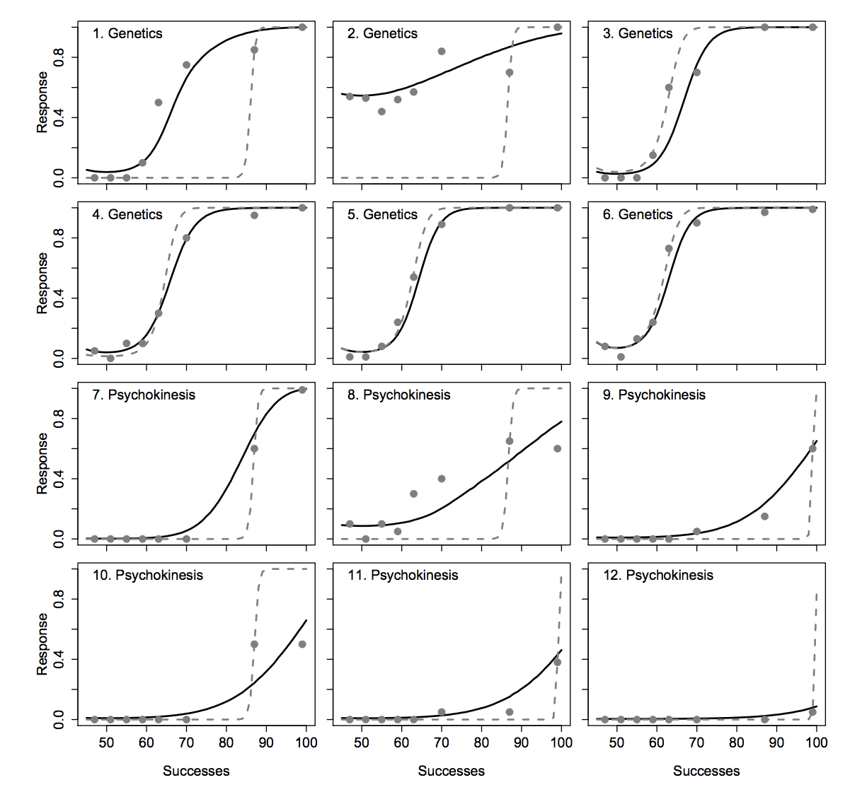
So yes, data analysis in R…
hierarchical Bayesian models with blah blah blah

Slide 13
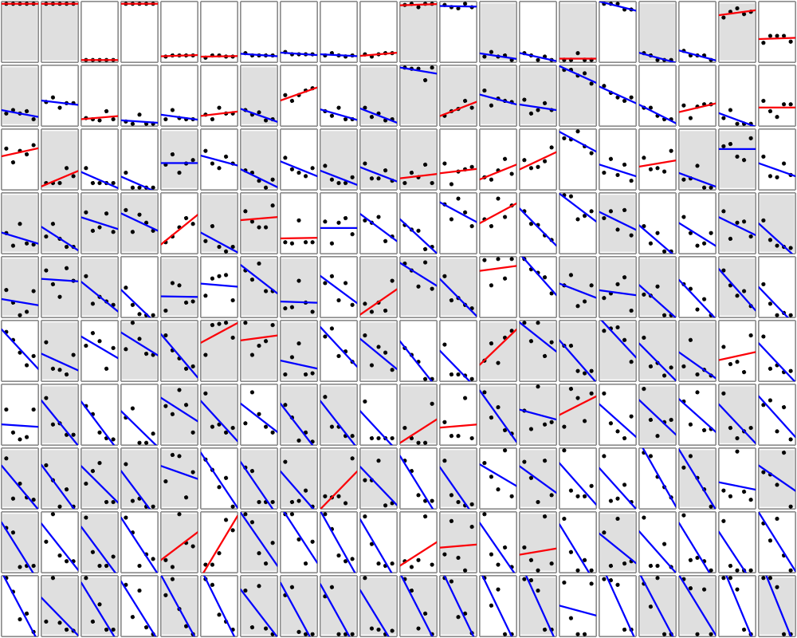
… very pretty data analysis!
visual representation of 200 regression analyses

Slide 14
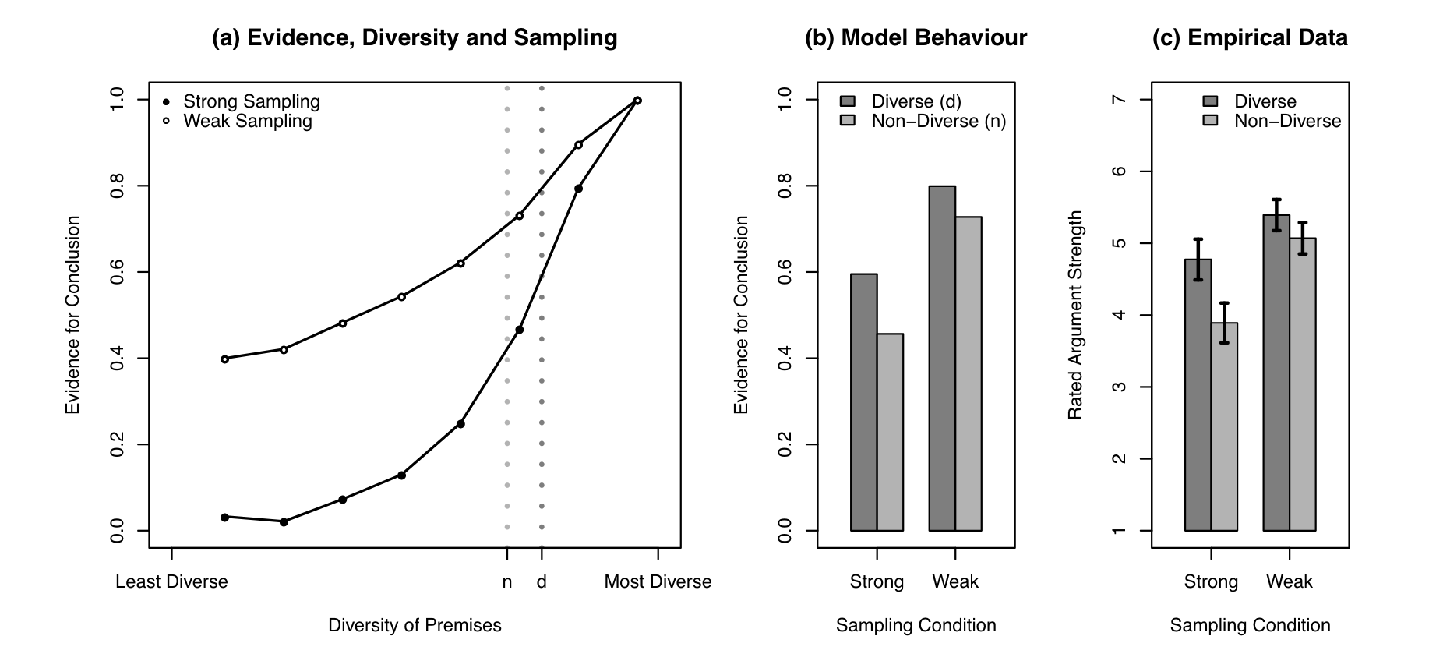
Useful for designing studies
I knew what the theory was, I knew what I wanted to manipulate…
But until I ran the simulations, I didn’t know whether to expect this to be a diagnostic experiment!

Slide 15
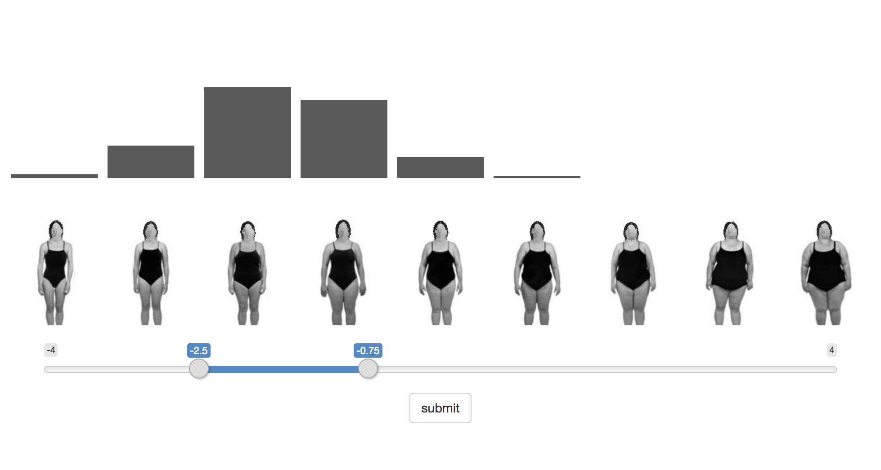
Useful for data collection
https://djnavarro.shinyapps.io/elicit/
(you can do a quick and easy text based version too, btw…)

Slide 16
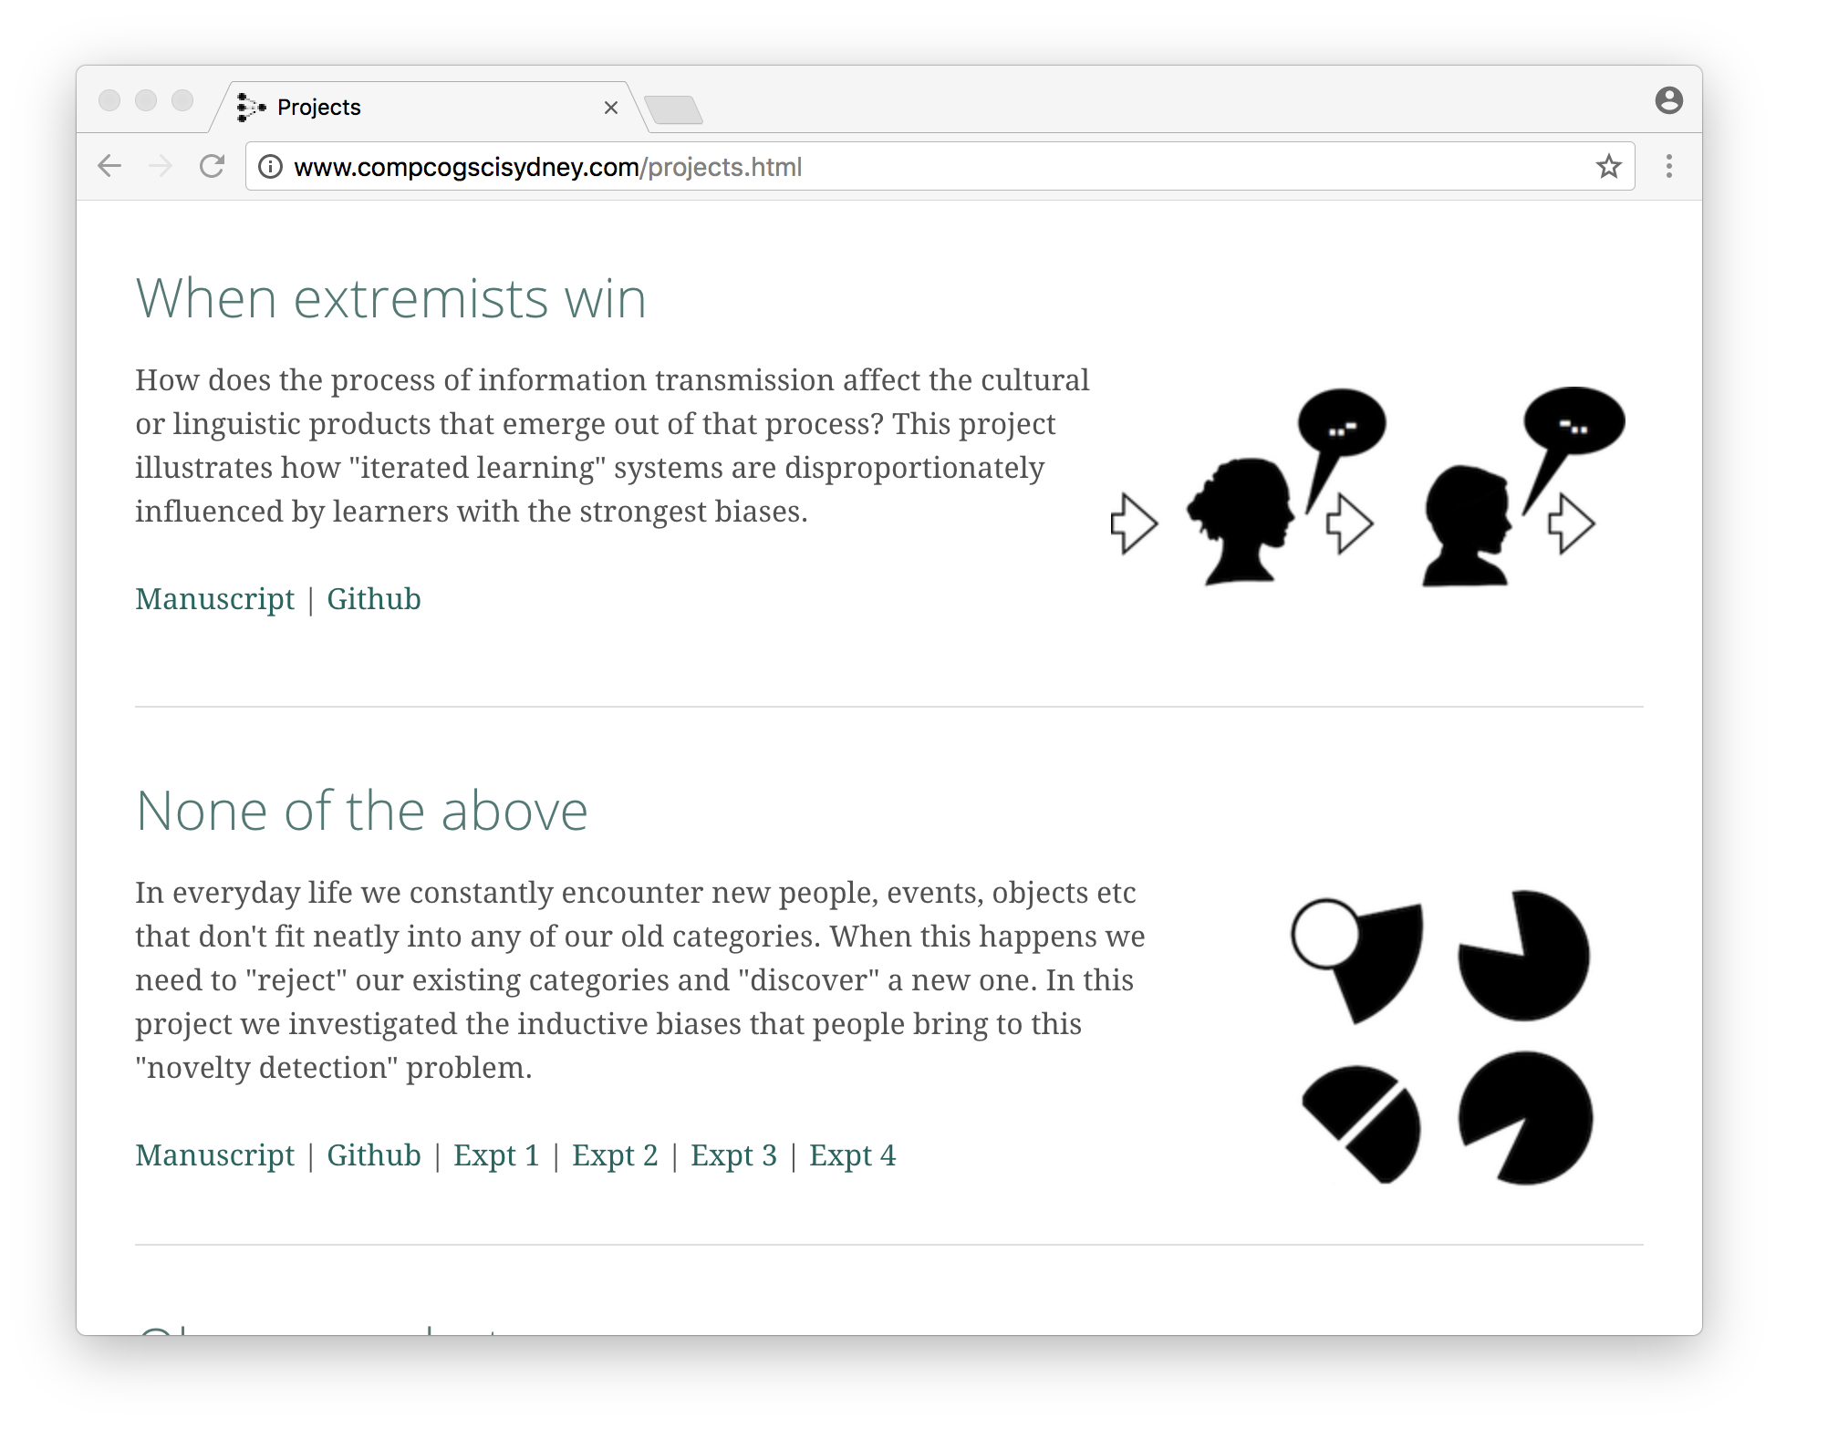
Useful for reproducible methods
links to working versions of the experiment code, and live demos of the experiment itself

Slide 17
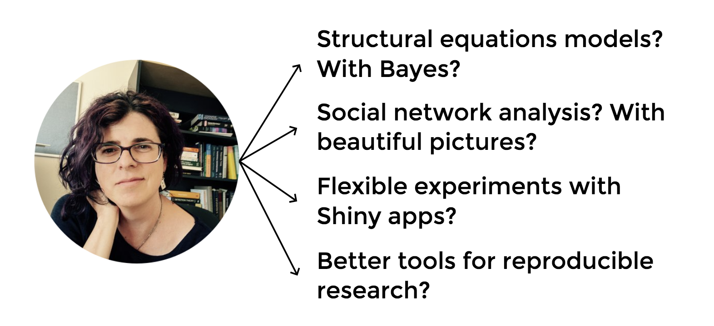
… lots of serious stuff

Slide 18
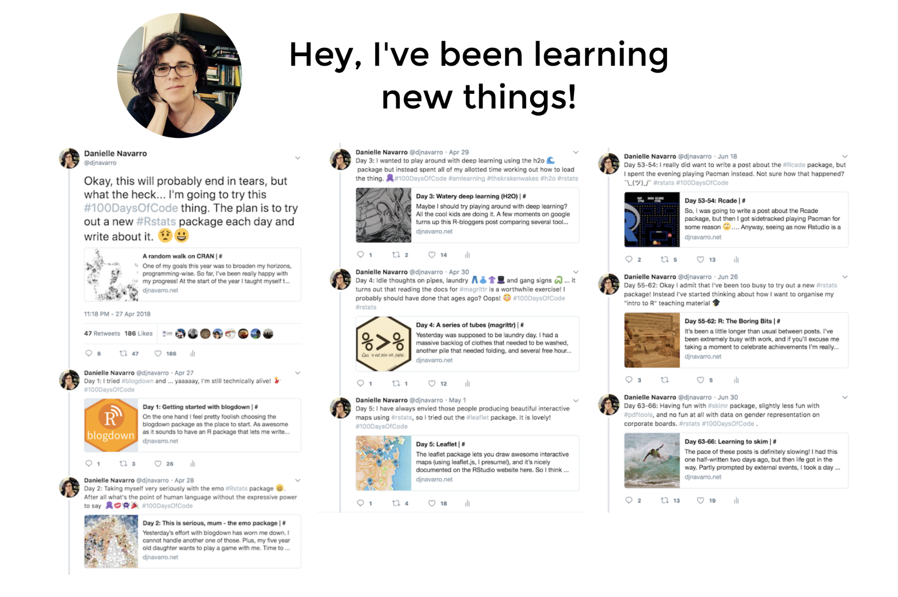

Slide 19
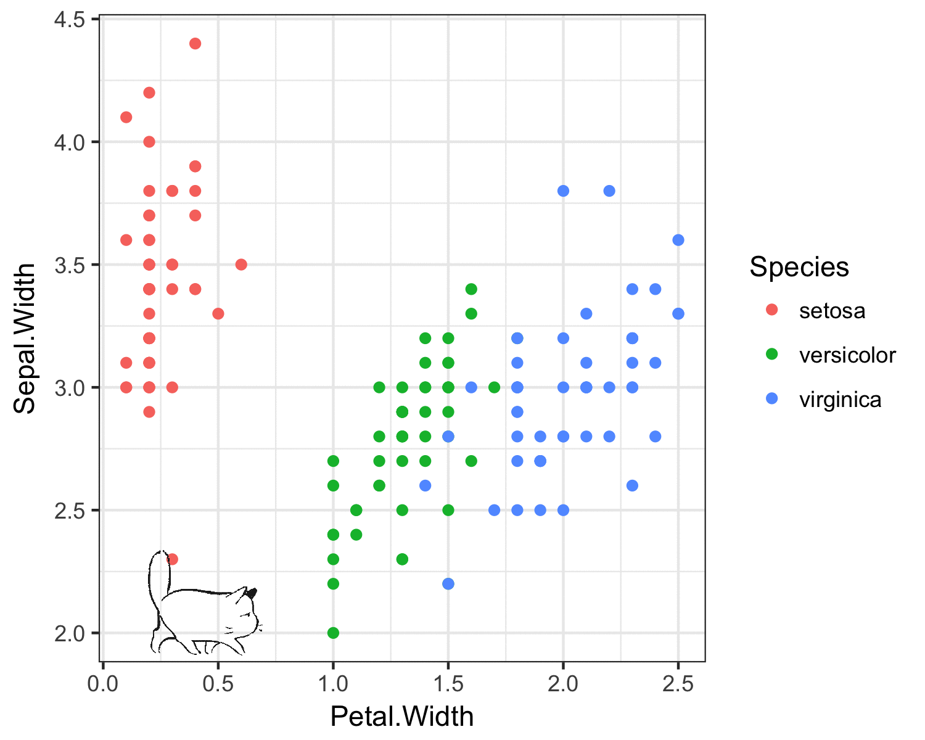
It can be fun!
http://djnavarro.net/post/2018-05-17-cat-gif-iris-magic/

Slide 20
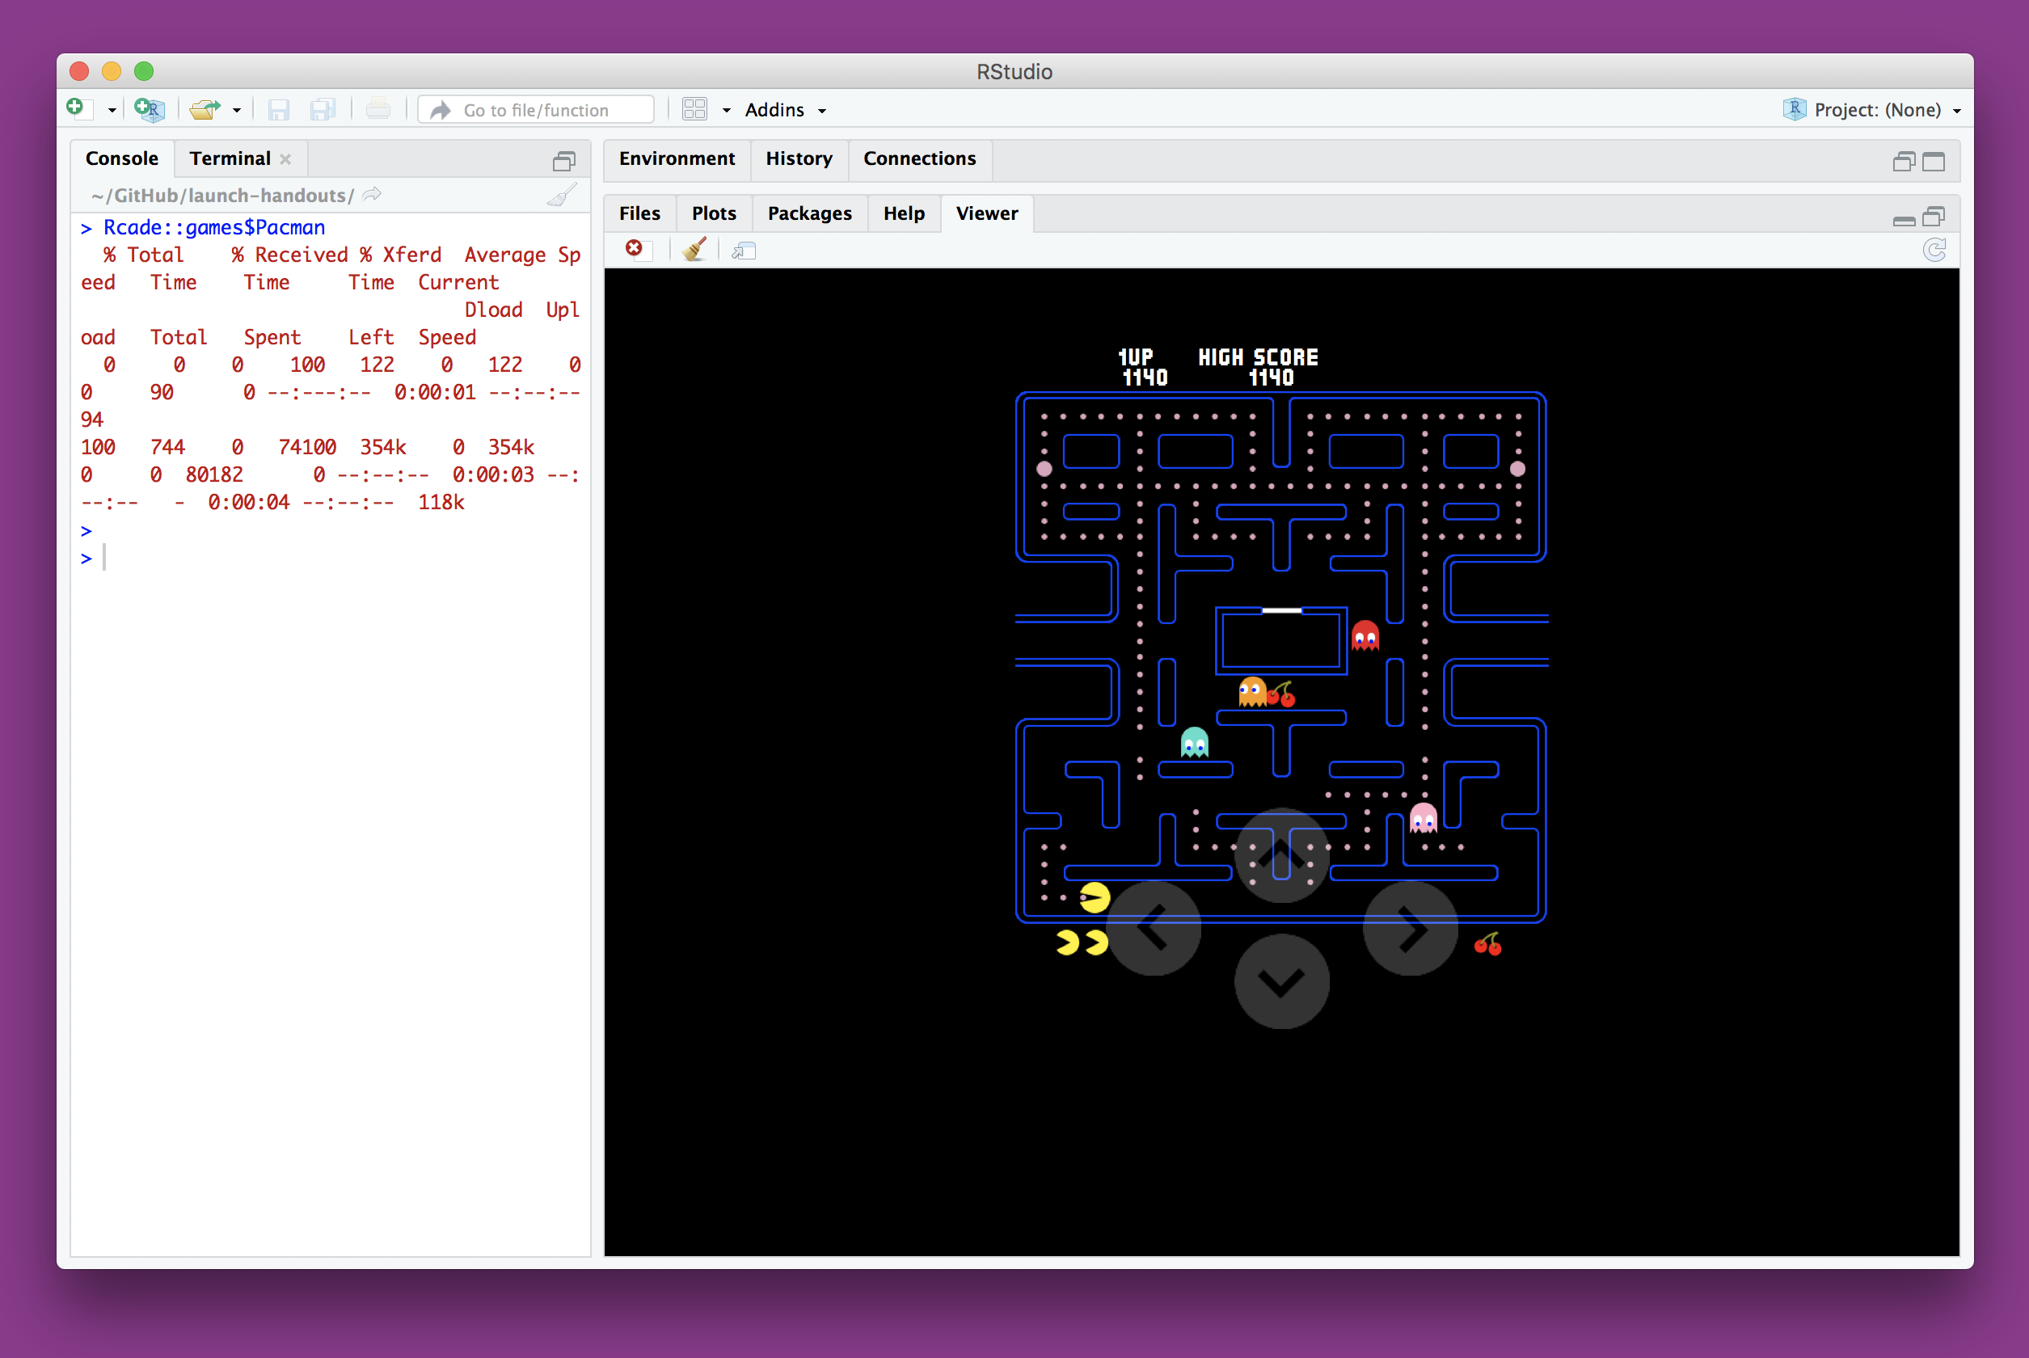
You can play pacman if you want…
http://djnavarro.net/post/2018-06-18-rcade/

Slide 21
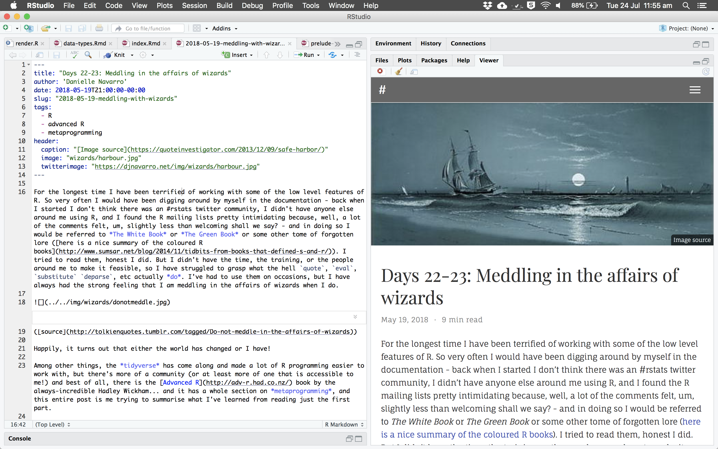
You can blog with R if you want!
http://djnavarro.net/post/2018-04-27-starting-blogdown/

Slide 22
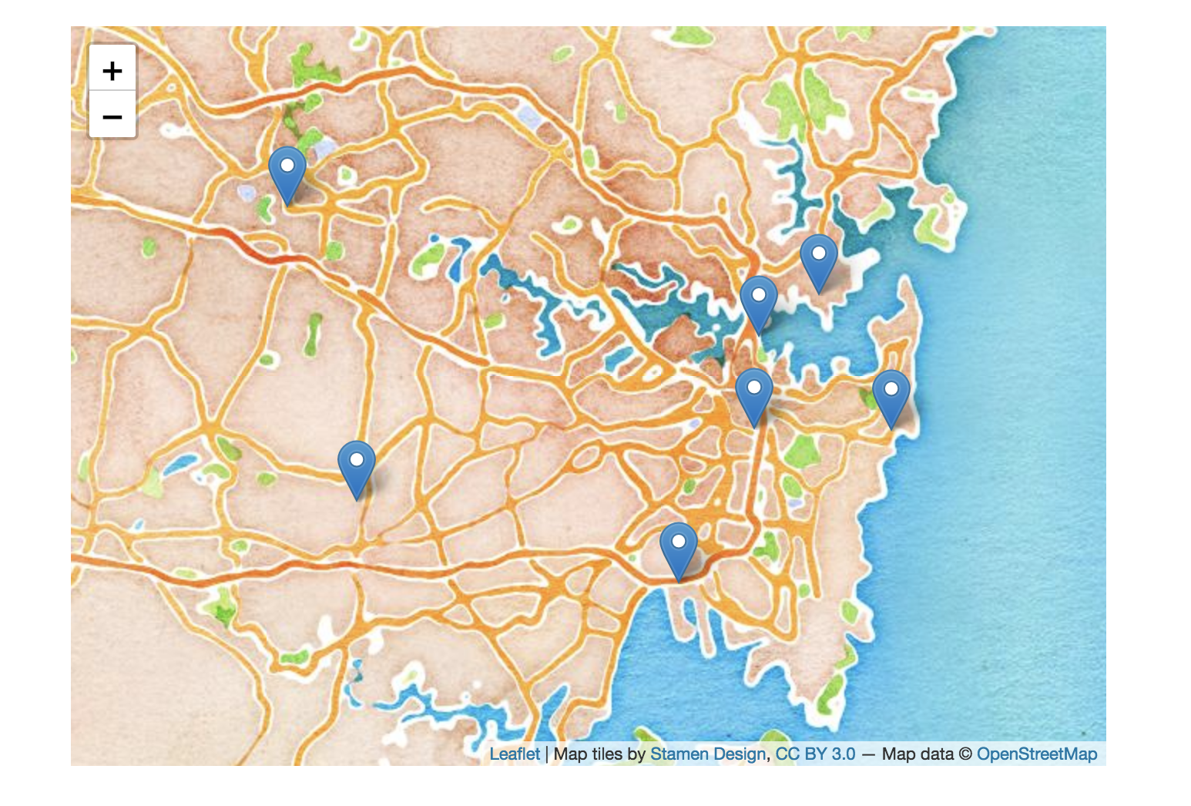
You can draw interactive maps!
http://djnavarro.net/post/2018-05-01-leaflet/

Slide 23
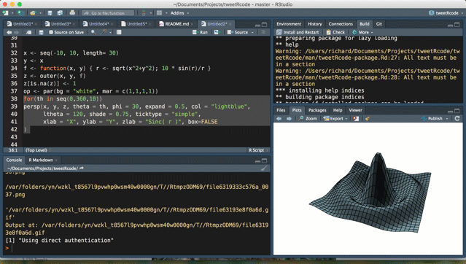
You can tweet from R
https://github.com/richarddmorey/tweetRcode

Slide 24
Discussion:
What do you want to do???

Slide 25
Why program?
A typical answer…
Develop problem-solving and algorithmic thinking
Automate repetitive tasks
Run experiments
Analyse data
Facilitate sound, reproducible, shareable research practices
Class poll:
What are some others?

Slide 26
Why program?
Flexibility & novelty?
Research often involves doing something that has never been done before.
You will have to invent the tool!
These technical skills give you the power to use your computer in ways that go far beyond what can be offered by any general or specialist application
Reproducibility?
Facilitates the creation of an accurate and comprehensive record of precisely what was involved in your research

Slide 27
Why program?
Algorithmic thinking
Successful application of technical skills requires an algorithmic approach and a problem-solving mindset. Programming, in particular, is very unforgiving of mistakes or imprecision—hunting down the cause of coding errors (‘bugs’) is in itself an excellent way of honing problem-solving skills and strategies

Slide 28
Disadvantages?
Discussion:
(are they worth pushing through?)
(how can we make it easier?)

Slide 29
Disadvantages?
Time better spent on other things?
Programming can facilitate the learning of other things—statistics and experiments become easier.
Not relevant for my particular area?
Every area could benefit in some way, even if just for data management and analysis
I can just hire someone to do it for me?
Very difficult to communicate requirements if don’t have programming understanding—plus, how would you know if it is done correctly?
Oh, and programmers are expensive!

Slide 30
Not a computer person?
Well maybe.
But for a lot people it’s just that they haven’t really had a chance to learn the skill. It’s just a trick.
Technical skills we will cover are uncorrelated with everyday notion of ‘computing’.
No need to learn complicated interfaces or abstract ‘clicking sequences’
More like knitting than computer games

Slide 31
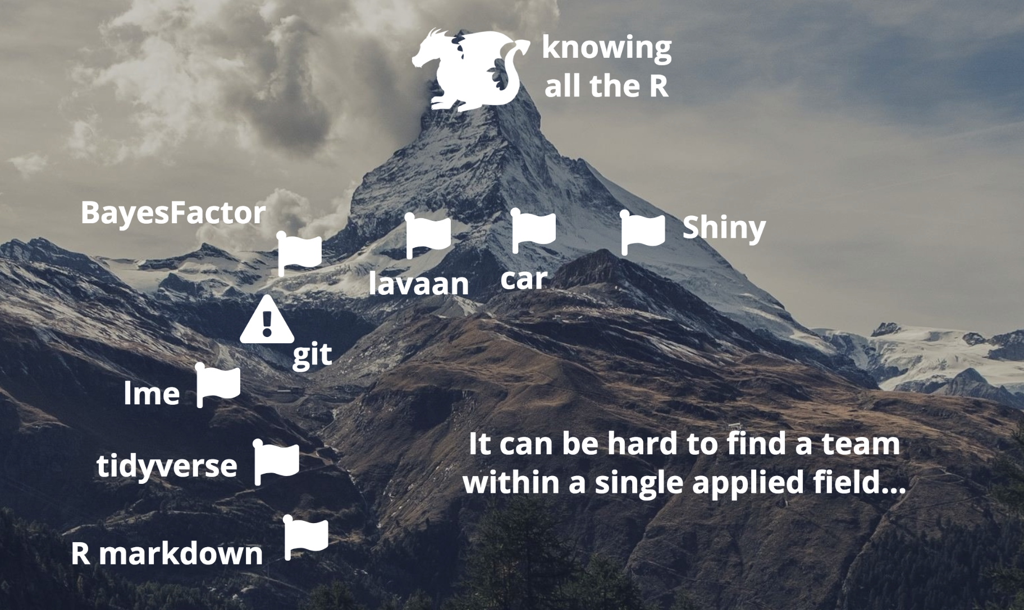
Be a team!!!!

Slide 32

https://psyr.org
Danielle Navarro
d.navarro@unsw.edu.au

